Slide 1
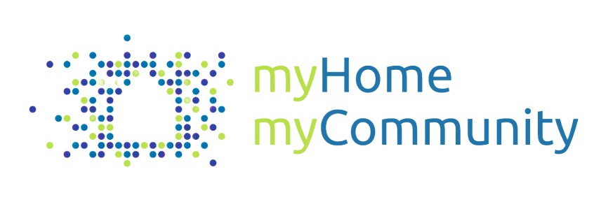
Inclusive Housing Toolkit #1
Partnership Driven
Housing Development

Slide 2
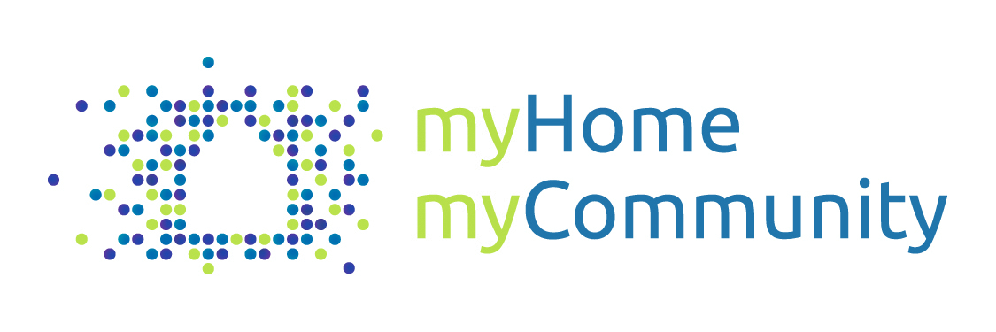



Acknowledgements
This report was produced as part of My Home My Community, a national initiative of the
Canadian Association of Community Living and People First of Canada.
Inclusive Housing Options for People with Developmental Disabilities received funding from
the National Housing Strategy under the NHS Demonstrations Initiative to produce this work.
The views expressed within are solely of the Canadian Association for Community Living, together
with project partners where expressly stated. Canada Mortgage and Housing Corporation (CMHC)
accepts no responsibility for the views expressed within.

Slide 3
Inclusive Housing Toolkit
What is it?
An overview guide on the pathways to replicating different models of inclusive housing for people with developmental disabilities
A reference tool that breaks down the process into digestible pieces, with tips and tricks, to be be adapted for your unique housing project
Who is it for?
  Organizations, communities, individuals, and families who are interested in kick-starting the development of inclusive housing
Project leaders, managers, and development teams who want to learn from the experiences of other organizations
About the Toolkit
Based on the development journey of the Community Living Toronto Case Study, this toolkit maps out a path to replicating this inclusive model
The information is organized into three levels:
  Project phases
  Major activities
  Tools and guides

Slide 4
Introducing the Series
  This is one of three development pathways detailed in this series. Each explores a different model for creating inclusive affordable housing for people with developmental disabilities.
Toolkit 1 Partnership Driven Development | Toolkit 2 Family Driven Development | Toolkit 3 Agency Driven Development
See www.myhomemycommunity.ca to access the full series, including toolkits and case studies, along with other resources to provoke and promote inclusive affordable housing for people with developmental disabilities.

Slide 5
Model 1 : Working with Developers
About the Model
Considerations
Working with developers (as demonstrated by Community Living Toronto) can be an option for organizations looking to secure housing units within larger developments.
This inclusive model involves an organization, such as a local Association for Community Living, partnering with a non-profit or private developer to co-create housing solutions for people with developmental disabilities. The housing form may vary, but typically the organization secures a number of affordable, dispersed units within a mixed building that are dedicated to tenants with developmental disabilities. The organization then provides the necessary supports to ensure tenancy and disability-related support needs are met.
For an organization that wants to explore inclusive, individualized housing, this model is relatively cost neutral and has lower financial risk compared to developing or purchasing units
This model may be particularly suitable for urban areas with high development activity, where there are ample opportunities for partnerships, and where developers may be incentivized to work with agencies
To make this model work, the agency must plan carefully to ensure that the support delivery meets the needs of tenants; they must also be prepared to address the changing needs of tenants over time
Organizations may not always be able to give input on the design of the development, depending on when the they become involved in the development process
Not outright owning units can be risky over time as long-term stability of rent and tenure cannot always be guaranteed

Slide 6
Key Themes and Principles
Successful Partnerships
Stakeholder Alignment
Tips for the Process
Having strong relationships with housing partners such the developer or landlord is crucial. Trust can be built by being flexible and available, clearly communicating needs, and showing dedication to the project.
It is important to ensure that all the parties involved are on the same page and given opportunities to ask questions, from organization leadership to front line staff and families/networks of support.
Document the entire process in detail
Keep the preferences and needs of people close to heart and ensure the process is informed by the philosophy behind the vision
Involve and consult with different stakeholders and experts as needed throughout the process
Be open to learning and pivoting along your journey; key moments of creativity, flexibility, and collaboration can lead to great solutions
Balancing Numbers
The Right Support
Balancing economies of scale for support services with the need for person-directed inclusion is a key consideration for the model.
Proper planning of supports around the needs of the residents and the constraints of the building can help to set up both the tenants and their support staff for success.

Slide 7
Pathway to Creating Housing
Discover
Define
Develop
Deliver
Extend
What is the outcome that meets the vision?
What are the actionable steps to creating this outcome?
Who do we need to work with?
What are the pieces we need to develop?
What final preparations do we need to make before we deliver the outcome?
How do we manage the transition from the current situation to the new situation?
What do we need to do to maintain and grow the outcome?
Is the outcome meeting the needs of all stakeholders?
What does the future look like?
What have we learned from our experience?
What is the problem we’re trying to solve?
Who are the stakeholders?
What are the needs of the people we serve?
What are we looking for in our approach to the solution?
What is the housing and support model we want to pursue?
What is the vision and concept of our solution?
What do we need to prepare to execute this vision?

Slide 8
Pathway to
Creating Housing
Phase 1 : Discover
Identify a Need for Change
Explore and Research
Consultation
Synthesize
The journey to creating new solutions is often triggered by dissatisfaction with the current state. What are the issues being faced and what are the forces for change? Initial conversations can lead to forming a group dedicated to discussing and pursuing the issue.
Gain inspiration by looking at existing innovative projects and models across Canada and worldwide. Discover background material in research papers, articles, and case studies. Make time to visit places and connect with organizations that have experience. There are also opportunities to attend conferences, workshops, and information sessions (or initiate your own event!).
Hold consultations with a variety of stakeholders to understand their perspectives on housing. Engaging people early in the process is important to gauge interest, gain insights, and gather support. Some of the most promising ideas and leads can emerge from these conversations.
Toward the end of the discovery phase, pull together all the different pieces of information that will help with defining a solution approach.
Notes

Slide 9
Consultation
In action:
Format: The consultation process could include several information-gathering activities, from a survey to in-person focus groups. For focus groups, there could be a combination of separate conversations with particular stakeholder groups and larger group conversations to bring the perspectives together.
Materials: A list of questions
Method: Consultation sessions may be facilitated by project leaders or volunteers. The session could be an open room discussion or include some conversations in smaller groups, with a share at the end. It is important to have designated note-takers and/or use handouts for participants to record their thoughts for post-forum compilation.
Tool Discover
Description:
Consultations are used to gather insights from stakeholders, such as people with a disability, their families and networks of support, support staff, community members, and other experts. The goal is to have structured conversations and hear from different perspectives, particularly people with a developmental disability and their networks of support, on what an ideal home and life would look like. Some of the outcomes might include identifying the needs of people with developmental disabilities and other stakeholders, discussing values and philosophy, and coming up with some initial solution directions.
Topics for Discussion
What is the concept of “home”?
What are the current challenges for people with a developmental disability related to finding housing?
How would people like to live?
What do people need to succeed?
What does inclusivity mean for people with a developmental disability and their families?
What are the guiding principles any solution must meet?
What are the hopes and fears for the process and outcome?
Notes:
*Look at what UNITI Chorus did

Slide 10
Synthesis
In action:
Format: Synthesis could be done in stages. It might start with a collaborative session where project leaders get together to sift through information, before dividing up tasks.
Method:
  Look at all the materials and notes
  Look for key insights, patterns
  Categorize and prioritize information
  Summarize into guiding document(s)
  Validate with stakeholders
Tool Discover
Sample Outputs
A summary of the problems with the current state and what people need or want
A mission statement and list of guiding principles: What are the goals? What are the values that guide us?
A definition of “home” and inclusivity
A list of parties who are interested in the project or wish to be involved
Description:
To wrap up the discovery phase, synthesis is a step to summarize all the information and key insights gathered into tangible outputs that can be shared and used in later parts of the project. This could be done by the project team and, as an extra step, validated by stakeholders who were involved in the consultation process.
Notes:
*Could include an example of Brockville/UNITI values, mission statement

Slide 11

Pathway to
Creating Housing
Phase 2 : Define
Vision and Concept
Research Potential Partners
Value Proposition
Finding Opportunity
Governance Structure
Using the synthesis of insights and guiding principles, begin working on solidifying the project vision. Holding a visioning session that brings together various stakeholders can help with narrowing in on a cohesive vision. A clear vision will also speak to developers and help them understand the needs of the organization.
The organization should begin thinking about the kinds of partners they would want to work with. There can be advantages and disadvantages to working with a for-profit vs. a non-profit developer, or a small vs. a large developer. Consider the qualities that are important in a partnership, such as the developer’s reputation, and begin to identify potential candidates that fit the description.
In every good partnership, there are gives and gets. As an organization, a good exercise is to consider the value you bring to a project as a partner. Explore different roles that the organization could take on, both during development and post-occupancy.
Opportunities can come through active seeking and relationship building – or being ready when someone reaches out. It can be worthwhile to explore both strategies: contacting potential leads and staying up to date on new developments, as well as making prospective partners aware of your intent and having information at the ready. The ideal scenario is to be involved in a development as early as possible.
When a suitable development partner has been found, it is important to sign a memorandum of understanding, which formalizes the relationship between the organization and the developer. This document should outline which party will be responsible for which aspects of the process and prevent surprises later.

Slide 12
Vision and Concept
In action:
Format: The visioning session could be a more hands-on workshop, with a balance of discussion and activities to help generate ideas for the vision.
Materials: Worksheets, synthesis materials (e.g. summary of needs, guiding principles), reference materials (e.g. best practices, an inclusivity guide)
Method:
  Using materials, brainstorm ideas for the solution
  Refine the concept and identify the design priorities and criteria
Tool Define
Sample Topics
Physical Building: location, number of units, number of bedrooms per unit, unit features, amenity spaces, outdoor spaces, proximity to supports and services
Tenure and Cost: tenure model (ownership, life lease, rental), proportion of units for people with disabilities, affordability levels
Supports and Services: what kinds of supports, roles in the building, partners, community benefits
Inclusivity: How do we make sure the vision and concept aligns with our vision for inclusivity, overall accessibility, unit accessibility, dispersion of units
Description:
Having a vision and concept that can be pursued is a tool to bring the project to life. The vision includes the scope of the project, the design criteria, and ideas of project components. Ideally, this process will involve participation from key stakeholders, as well as project leaders, to “co-design” the vision. A consultant might be brought on at this point to design, facilitate, and summarize the visioning sessions.
Notes:
*Could include an example of Brockville/UNITI values, mission statement

Slide 13
Value Proposition
In action:
Method:
  Conduct research into the financial and non-financial resources the organization can contribute to a development, as well as the available incentives or funding programs in the community for developers to work with non-profit agencies
  Organize discussions with leadership and staff to develop consensus on the outline of a value proposition document
  Develop a value proposition document for internal and external use that synthesizes the information collected
Tool Define
Description:
There are several reasons why it would be beneficial for a developer to partner with an agency supporting people with disabilities or other priority groups. For example, having a support agency in the building increases the number of eyes in the building and can mean residual supports and a greater sense of community for the whole building. In addition, a number of federal funding programs and local municipal incentives require developers to partner with other organizations to access the funding or incentives offered. Understanding the value the organization might bring to a developer and articulating this in a persuasive value proposition document can help convince developers to enter into a partnership.
Sample Questions
What are the resources, knowledge, and expertise that the organization may bring to a development?
What is the added value to having the organization present in a building or community?
What are the benefits or business incentives for a developer to work with a non-profit agency?

Slide 14
Finding Opportunity
Tips:
Work together with the local planning department to stay on top of proposed developments in the area
Try to be involved early in the project, such as at the proposal stage, to ensure there are opportunities to give input on the design and concept
Build trust and lasting relationships with potential partners by being available, providing quick responses, setting up in-person meetings and staying in touch regularly
Show dedication by having key stakeholders write letters of support, go to community meetings, and advocate for the project
Stick to the vision and concept, but work with the partner to understand their needs and have flexibility to find middle grounds
Guide Define
Description:
While sometimes opportunities present themselves, other times they require more work and preparation. This work may include allocating resources to keep track of new developments in suitable locations, as well as developing and maintaining good relationships with developers in the community. In addition, it would be important to be prepared and ready to move quickly when an opportunity arises.
Checklist
Develop a vision and concept
Prepare value proposition documentation that can be shared with potential partners
Assign resources to identify, build, and maintain relationships with potential partners
Create a list of proposed developments in the area

Slide 15



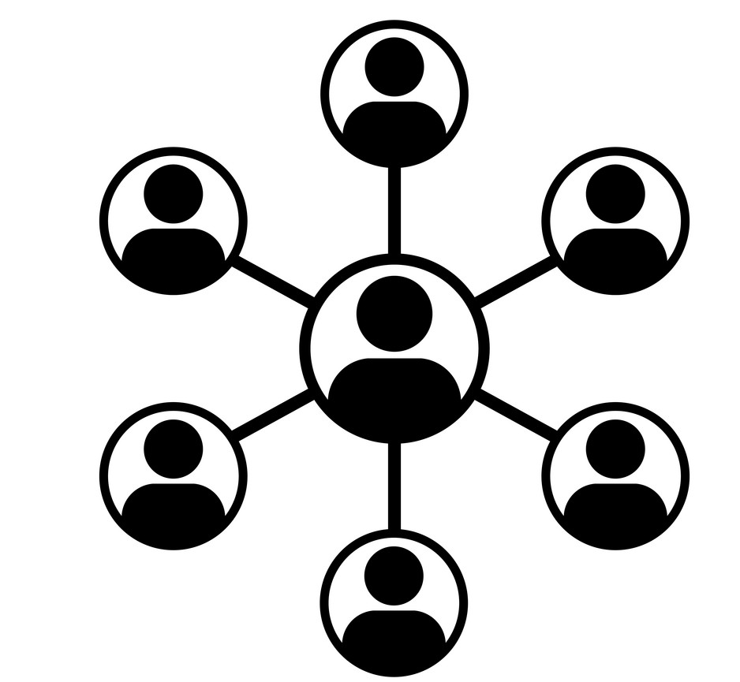
Pathway to
Creating Housing
Phase 3 : Develop
Project Team
Design
Confirm Tenants
Ensure Affordability
Support Model
Having a dedicated project team is important to steer the project and execute the move. The team may consist of a project manager, program managers, supervisors, supports and housing workers, and other relevant members. Working with partners, experts, and other stakeholders, the team should meet regularly to ensure that the project is on track and the necessary preparations are
taking place.
It’s ideal to have as much design input early in the process as possible. The design process could involve further consultations with primary stakeholders such as individuals and families to understand how their needs can be incorporated into a particular development. The organization should also participate in larger design sessions with the project partner.
By this point, there are likely individuals and families that have expressed an interest in this model. Potential tenants may be prioritized on a needs-basis, such as living in an unsuitable situation. It’s important to have extensive conversations with the potential tenant and their network of support on their goals and needs in order to determine if the model will be suitable.
The rent levels must be affordable. Organizations may be able to work with developers to obtain units Rent-Geared-to-Income, equal to the level of funding that tenants with disabilities receive. Further ways to ensure affordability may include seeking housing allowances, sharing a multi-bedroom unit between chosen roommates (if appropriate), and financial contributions from families.
It’s important to design a support model that works with the physical space, while meeting the needs of tenants with a disability. Within a centralized support system, staff should be trained on how to work with a “just enough support” approach, while potentially supporting more individuals. Having familiar support staff can help tenants transition to their new home, but some paid support staff may have difficultly adapting to a new individualized style of work.
Notes
Notes

Slide 16
Project Team
In action:
Format: The team could meet regularly (e.g. biweekly or monthly) to discuss progress and maintain interdepartmental alignment. In addition, the team could meet occasionally with the development partner when key decisions are being made.
Materials: See Project Team attachment
Tool Develop
Tool Develop
Project Dynamics
Project Team
Project Manager
Description:
Creating a project team with a a dedicated project manager can help keep the organization on track, maintain internal alignment, and develop a strong relationship with the development partner and other stakeholders. This team should meet regularly and occasionally with the developer to discuss project progress and key issues as they come up.
Coordinates with partners and stakeholders, ensures internal deadlines are met and works to mitigate risk for the board, staff, prospective tenants, and families
Development Partner
Other Team Members
Key Stakeholders
Other members should be decision makers from all departments affected by the project and could be engaged as required to co-ordinate the allocation of resources throughout the organization.
Notes:
Include diagram of project team

Slide 17
Design
In action:
Format: Host a number of co-design sessions with the project team and the development partner to help translate the importance of the vision to the developer.
Materials: Visioning summary, initial designs for the building, and examples of design
Method:
  Building off the vision, present pre-developed ideas and principles to the developer, including concepts for the space and support model
  Explore together what might be feasible in the building and on the site
  Discuss trade-offs and set priorities to help the developer refine and finalize the design
Tool Develop
Tool Develop
Additional Design Considerations
Description:
In an ideal scenario, the project team is able to have significant input on the design of the building and the units. However, this is dependent on the stage of the development at the moment the MOU is signed. Collaboration on the final design can ensure the building as a whole meets the needs of all stakeholders involved including the development partner, support staff, and key stakeholders. In particular, having resident input on the design can lead to a more inclusive outcome.
Number of units (economies of scale vs. proportion of tenants with a disability)
Unit size (number of bedrooms) and features
Dispersion of units for people with developmental disabilities
Quality/durability vs cost of appliances and finishes
Amenities, common spaces and social connection points
Staff space and work flow
Proximity to services (or designing for mixed-use)
Cost and affordability
Accessibility, health and safety
Visitability (for guests), building access and security
Parking or transportation

Slide 18
Select Individuals
Tool Develop
Tool Develop
In action:
Format: Host in-person conversations between staff and individuals and/or their families.
Method:
  Ensure the staff member approaching the individual and/or family is familiar with their situation
  Develop a communication plan about the benefits of the new living environment in the development
  Explore the feasibility of what living in the new development might look like and if it would meet the needs of the individual
Description:
After construction has started, it is important to begin the process of tenant selection. There might be a list of interested individuals and families from previous consultations. In addition, there might be individuals the organization supports or is aware of who are living in unsuitable homes (e.g. older adults who require accessible housing, people living group homes in need of major repairs). It would be important for project leaders and staff to engage these individuals and their families early to discuss if the new building would suit their needs and allow them sufficient time to prepare for their move.
Sample Questions
What does home look like for the individual?
What are the requirements for the physical home (e.g. accessible features)
What are the requirements for support (e.g. 24-hour care)?
Would the individual be interested in living with a roommate?
What is the monthly budget available for housing?
In what roles would the individual’s family or support network like to be involved?
Notes:
Could use some UNITI stuff

Slide 19
Support Model
In action:
Format: Workshop sessions with the project team, prospective support staff, tenants with developmental disabilities and their families
Method:
  Map the needs of the individuals who will be moving to the building.
  Consider who, what, when, where, why and how supports will be delivered.
  Co-design support solutions to work around physical and other limitations of the building.
  Develop a support model.
Tool Develop
Tool Develop
Tips
Description
Developing a support model should be a collaborative process that brings together the project team and support staff, driven by the tenants and their families. It would be important to select the staff who will provide supports in the building at the time as the tenants.
The support model should focus on the needs and values of the individuals.
Involve front line workers in consultations to co-design procedures and channels of communication.
Consider creating staffing hubs out of larger units that house several individuals requiring intensive support, by making staff supporting these individuals available to provide occasional supports to independent individuals in their own apartment.
Consider organizing staff orientation and site tours to make them familiar with the new work space prior to the workshop sessions.

Slide 20
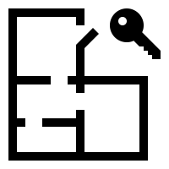

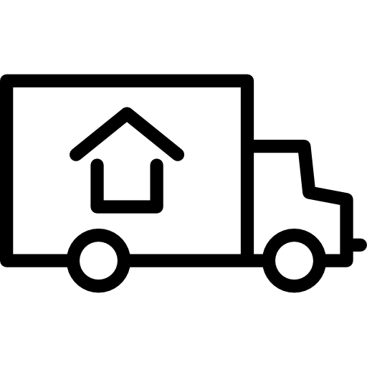


Pathway to
Creating Housing
Phase 4 : Deliver
Foster
Inclusivity
Assign Units
Lease Agreement
Preparation for Move-in
Move-in
Once the construction is completed, families and individuals should be invited to tour the building and choose their own apartments from the allocated spaces, if possible.
There are different forms of agreements that can be used to formalize the relationship between the individual, the support agency and the landlord, ranging from a head lease to a referral agreement or something in between. It’s important for the organization and the partner to openly discuss their fears and potential risks.
Depending on where the individual is coming from, the preparation for move-in may be organized by the individual along with their family and/or support staff from the previous home. The organization may provide some assistance.
The move-in process may be overseen by the individual’s family and/or support staff. For those transitioning from a different type of support model, it can be helpful to hold vacancy for a period as a precautionary measure.
Moving into a new building at the same time as other residents can help boost inclusivity and allow individuals with developmental disabilities to be part of creating the building culture. Further efforts can be made to help all tenants get to know one another by holding social events, answering questions, educating each other, and having individuals present at meetings in the building.
Notes

Slide 21
Potential Agreement Structures
Lease Agreement
Head Lease
A head lease is a structure where the agency signs an agreement with the landlord to operate the unit on their behalf. The agency signs a sub-lease with the tenant and collects rent which is then paid to the landlord.
Benefits
Landlord is not responsible for collecting rents
Drawbacks
Non-typical (non direct) relationship between tenant and landlord; not empowering to persons with developmental disabilities
Referral Agreement
A referral agreement is a structure where the agency signs an agreement with the landlord that they will get to refer a tenant to the landlord for a specific unit. When a suitable tenant is found, the tenant signs a lease with the landlord.
Benefits
This agreement establishes a direct relationship between the tenant and the landlord
Drawbacks
Landlord is responsible for rent collection and may be overly cautious in this regard
Hybrid
In a hybrid model, there can be a referral agreement and a regular lease between the tenant and the landlord, but with a specific mention in the referral agreement that the agency is responsible for monthly rent collection.
Benefits
Establishes a direct relationship between the tenant and the landlord while removing rent collection
Drawbacks
More complex to implement; less empowering to persons with developmental disabilities
Tool Develop
Guide Deliver
Description
There are different forms of lease agreements, from a head lease to a referral agreement or something in between. It’s important for the organization and the partner to openly discuss among each other how they want to formalize the arrangement before the tenants move in. This should include discussion about the potential risks with each type of agreement.
Key Considerations
A model that allows people to sign a lease directly with the landlord is considered most inclusive and empowering to the tenant.
Obtaining a long-term head lease or referral agreement of 10 years or more is ideal to ensure stability of tenure.
Ensure the project team takes the time to explore these options with the development partner, while remaining open to alternatives or variations of these agreements.
Notes:
Could we create a template?

Slide 22


Pathway to
Creating Housing
Phase 5 : Extend
Ongoing Work
Independent Living
Reflection and Feedback
Sector Collaboration
As ongoing work, the organization provides the individuals with the supports they need for successful tenancy. The organization may also want to establish an internal team to dedicated to exploring further development opportunities and strategies. For organizations that are transitioning individuals from other properties to this new model, there may be work to be done in repurposing existing buildings and land.
While the organization’s main focus may be providing supports to individuals with developmental disabilities, it is important to consider a team-based approach in partnership with the landlord and superintendent to address any issues. It’s also critical for staff and the organization to communicate regularly with families if relevant.
It’s important to create opportunities to reflect on learnings and collect feedback from the various stakeholders involved in the process.
Forming a housing coalition with a group of agencies can be a way to minimize competition and increase opportunities to collaborate with developers. As an organization with experience, sharing resources, participating in events, and telling your story is a good way to inspire others and to promote your organization.
Notes
Notes

Slide 23
Independent Living
Tool Develop
Tool Extend
In action:
Format: Check-ins could be in the form of questionnaires for individuals to fill out, with help from support staff if needed, or through an informal interview, individually or in small groups.
Materials: A list of questions
Sample Questions
What is going well?
What is not going well?
What could be changed?
Do you have any ideas?
What do you need less or more help with?
What questions do you have?
Description:
Having periodic check-ins with tenants, especially within the first year of occupancy, can be a good way to gain insights on the experience of independent living for tenants with a disability. These check-ins can be facilitated by the project leaders or individuals’ support staff, with follow-up on any specific issues that need to be addressed.

Slide 24
Reflection and Feedback
Tool Develop
Tool Extend
In action:
Format: Feedback could be collected through questionnaires or a session that brings together different stakeholders for a discussion. The discussion could be facilitated by a member of the project team or an outside party.
Materials: A list of questions, the guiding principles (to evaluate the solution)
Sample Questions
Does the solution hold up to the principles and vision?
What was the process like and how can it be improved in the next iteration?
Families and Support Staff
What are some of the accomplishments and challenges?
What does your support role look like and how do you feel about it?
Description:
A reflection tool can be used to gather feedback from people involved in the development process, from the project team to stakeholders that were part of consultations. This is an opportunity for project leaders to hear and reflect on learnings from the process: what went well and what didn’t? What could we do differently next time?

Slide 25
Sector Collaboration
Tool Develop
Tool Extend
In action:
Format: An alliance of interested organizations who meet on a regular basis to discuss potential development opportunities.
Method:
  Create a set of collaboration principles
  Develop a united vision and value proposition on a one-pager that describes the common issue the group wants to address, what is required to solve it, and how partnerships might help achieve these goals
Sample Outputs
Description
Forming a housing coalition with a number of likeminded organization can help make finding partnership opportunities more efficient by coordinating efforts to ensure there is no competition. In addition, working together might be a way to secure gain more influence over the design of the building and the units due to economies of scale.
A website listing all group members and initiatives
A list of issues that the group is looking to address (e.g. lack of housing, need for affordable housing)
What the group needs (from the government, development partners, etc.)
Notes:
Could create a template

Slide 26
To learn more about inclusive housing models:
www.myhomemycommunity.ca

